Slide 1
ASP.NET Core

Slide 2
ASP.NET Core Fundamentals
Startup and Middleware
Notes:
ASP.NET Core Fundamentals
In this chapter, we're going to move forward with our application and set up our middleware.
Middleware in ASP. NET Core controls how our application responds to HTTP requests.
Middleware is also how we display error information, and it's a key piece in how we authenticate and authorize a user to perform specific actions.
We're going to learn a bit about how middleware works in this chapter and how to set up middleware during application startup.
By the end of the chapter, we'll have a processing pipeline that allows us to use ASP. NET MVC.

Slide 3
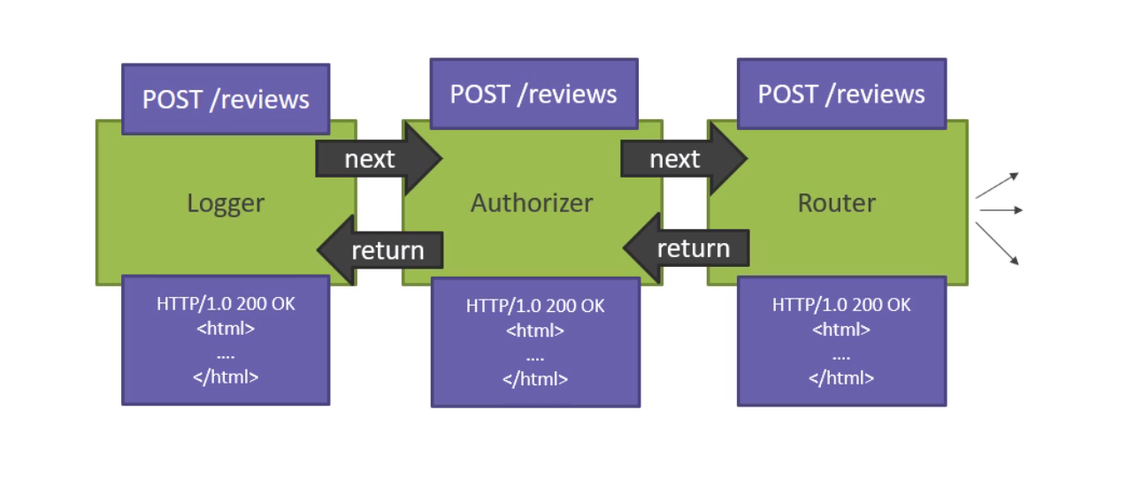
How Middleware works
Notes:
How Middleware works
When an HTTP request arrives at the server, it is ultimately middleware components that will determine how to process a request.
Let's pretend we have an HTTP POST request to the URL /reviews.
Perhaps this is a call to create a new review. What we need is software that will respond to that request.
In ASP. NET Core, each piece of middleware in ASP. NET Core is an object, and each piece of middleware has a very specific focused and limited role.
We need many pieces of middleware for an application to behave appropriately.
First, let's imagine that we want to log information about every request to our application.
The first piece of middleware that we might add to an application is a logger.
The logger can see everything about the incoming request, the path, the query string, the headers, any cookies and access tokens.
The logger can record information about the request, even change information about the request if it wanted to or reject the request and stop processing right away.
But chances are, a logger is simply going to record some information and then pass along the request to the next piece of middleware in the pipeline.
That's the next piece of middleware that we've added to our application.
Let's say we've added an authorizer.
An authorizer might be looking for a specific cookie or access token in the headers.
If the authorizer finds the token, it allows the request to proceed. If not, perhaps the authorizer itself responds to the request with an HTTP error code or redirect to send a user to a login page.
Otherwise, the authorizer will pass the request to the next piece of middleware.
Perhaps this middleware is a router.
A router might look at the URL and try to figure out that you want to call some method on a class.
Maybe that method returns JSON data or XML data or an HTML page.
The router's responsibility is to look all throughout the application for something to respond to this request, and if it doesn't find anything to respond, it could return an HTTP 404 Not Found error, or the router might find the right component and that component produces XML or JSON.
And then the pipeline starts to reverse.
This is a classic pipeline design pattern, but it's bidirectional.
The request flows into the middleware in the order that we added that middleware to the application, and when a particular piece of middleware or some other component produces a response, that response flows back out through the middleware.
The router would return control to the authorizer that would be able to see that response.
The authorizer probably is not interested in a response, but the authorizer will return control to the logger, and when the logger sees that the rest of the pipeline is finished, it might record that fact and log the total amount of time taken to process this particular request.
Then this HTML response that we've produced with a 200 OK status okay, would flow out of the server and over the network to the client who is waiting for this result.
This is the essence of what middleware is all about in ASP. NET Core.
We set up a series of components to make our application behave a specific way, and respond to HTTP requests.
We probably want to add middleware to handle errors.
We will need middleware to serve up static files that live on the filesystem.
We need middleware to send HTTP requests to the MVC framework, which we'll do later in the course, and that will ultimately allow us to show restaurant information to users.
Perhaps that restaurant information is an HTML, or could be in JSON or XML.
We’re not going to give you all the low-level details about middleware in this course, but let us show you enough of the basics that you can move forward and understand how this pipeline works in an ASP.NET Core application.

Slide 4
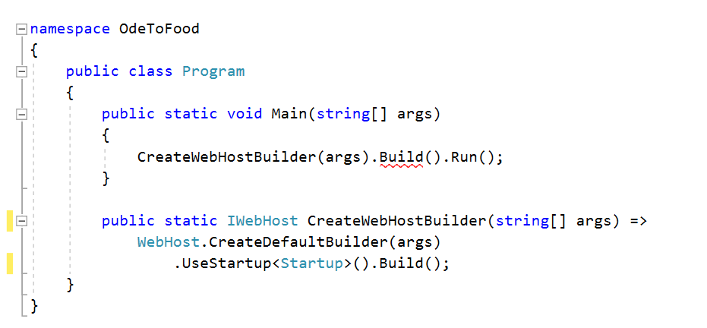
Using IApplicationBuilder
Program.cs
Notes:
Using IApplicationBuilder
Inside an ASP. NET Core application, when the application begins to execute and we are configuring our web host using a builder, we can register a class that represents our startup logic using this UseStartup method.
What ASP. NET Core will do is instantiate this class and invoke two methods.

Slide 5
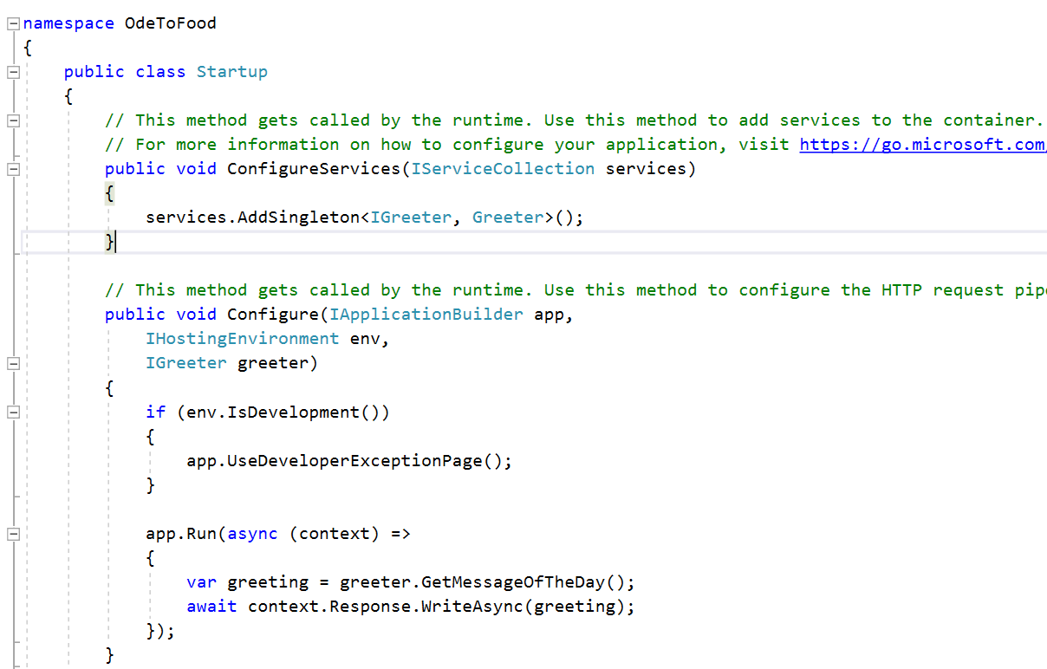
Using IApplicationBuilder
Notes:
Using IApplicationBuilder
The first method is the ConfigureServices method.
We used that in the last chapter, and it is this method where we can register services for ASP.NET Core to inject into other components.
That includes both custom services, like the Greeter service that we have created, as well as other services provided by ASP.NET that are just not registered by default.
For example, when we start using the MVC framework to produce HTML and JSON, we're going to need to register a group of services that the MVC framework requires, but we'll get to that later.
The second method that ASP. NET Core will invoke is the Configure method.
It is inside of this method, that only ever executes once; where we configure our middleware using the object that implements IApplicationBuilder.
So we are building an application and adding middleware to handle HTTP request in a very precise way,

Slide 6
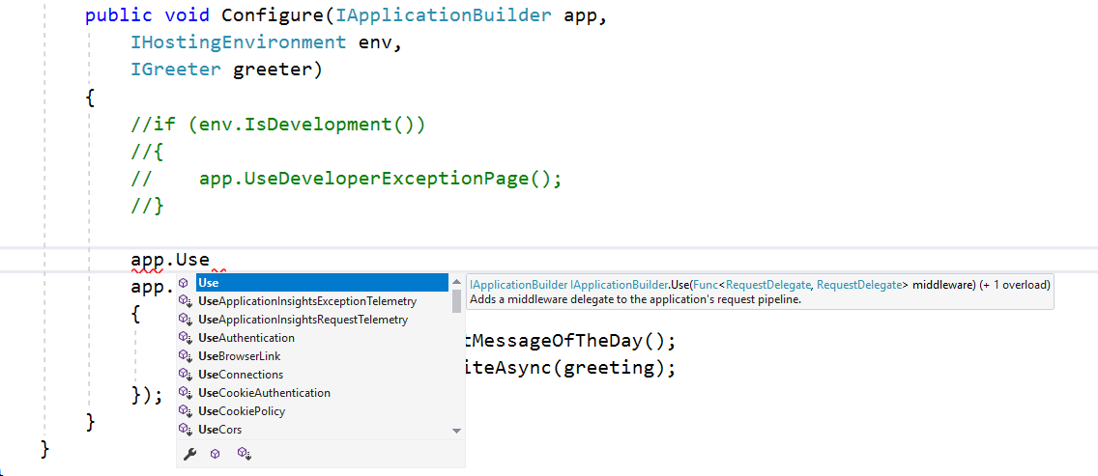
Use IApplicationBuilder
Notes:
Use IApplicationBuilder
Currently there's just two pieces of middleware inside of Configure.
One is UseDeveloperExceptionPage.
For right now, we’re going to comment this code out using Ctrl+K and C. We will come back to that in a moment.
That leaves us with just one piece of middleware, the little bit of code that is registered using app.Run.
app.Run is something you don't normally see in a real ASP.NET Core application, because you can really only use that to register very simple middleware, middleware that just perhaps writes directly into the response and displays some text, although you could do HTML or JSON here also.
Most of the middleware that you will install in a real ASP.NET Core application is middleware that you install by going up to this application builder and invoking a method that starts with the word Use.
And you can see in the IntelliSense window there's quite a number of methods that start with the word Use.
These are all extension methods for IApplicationBuilder.
As you install different NuGet packages that might contain more pieces of middleware, you'll have access to more Use methods that allow you to install different pieces of middleware.
There's middleware to set up cross origin resource sharing headers (UseCors).
We can install middleware that allows the user to browse directories on my filesystem (UseDirectoryBrowser).
There's middleware here to use the MVC framework (UseMvc), model view controller.
We'll need to add that middleware later in the course.

Slide 7
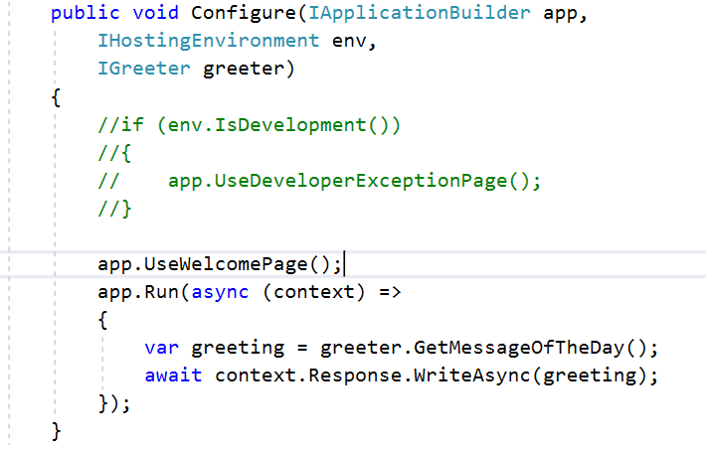
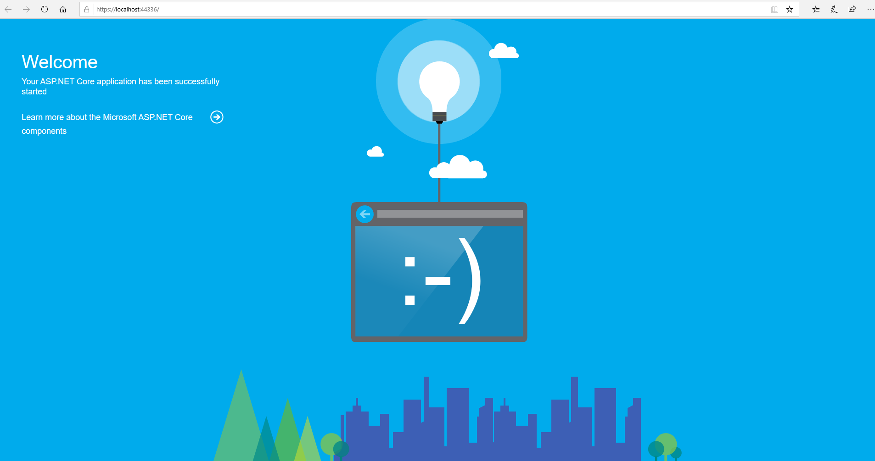
Use IApplicationBuilder
https://localhost:<portnumber>
https://localhost:<portnumber>/foo
hpps://localhost:<portnumber>/bar
Notes:
Use IApplicationBuilder
For right now let me find a piece of middleware that I install using UseWelcomePage.
Like app.Run, this is a simple piece of middleware, and it's going to respond to every request by default and display a simple welcome page.
So it might be useful for diagnostics.
If you save Startup.cs and come back to the browser, when you refresh, you will see the result of the UseWelcomePage middleware.
What we want to point out for right now is that you have to be careful about the order in which you install middleware.
Because UseWelcomePage responds to every request, it doesn't matter we go in the application, we could go to /foo or /bar, every request is going to look like this welcome page.
The middleware that we have inside of app.Run that displays a greeting will never have a chance to display, because UseWelcomePage will never call the next piece of middleware in the pipeline.

Slide 8
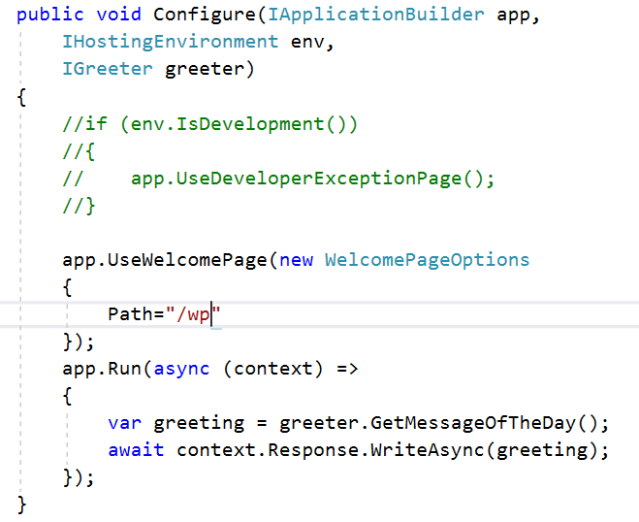
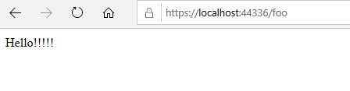
Use IApplicationBuilder
https://localhost:<portnumber>/wp
https://localhost:<portnumber>/foo
hpps://localhost:<portnumber>/bar
Notes:
Use IApplicationBuilder
However, there are some options that you can pass to UseWelcomePage.
Many pieces of middleware will allow you to pass along an options object, in this case the options object is the WelcomePageOptions class that I need to instantiate, and in these options we can set a path for the welcome page to use, so it only responds to a request whose path in this case would be /wp.
Let’s save Startup.cs, come back to the browser, and if we refresh on /bar, that request is going to tunnel through all the middleware and hit app.Run where we will display our greeting.
Because UseWelcomePage inspected that request and said no, we’re not going to handle this one, let's just pass it along to the next piece of middleware.
If we go to instead of /bar, go to /wp, we're back to the welcome page.
Throughout the rest of this chapter, and even later in the course, we're going to be installing different pieces of middleware, and we'll always give you an idea of where that middleware should appear among all the other pieces of middleware that you have, because the order in which you invoke these use methods is significant.

Slide 9
Async / Await
Avoid performance bottlenecks
Enhance the overall responsiveness of your application
For activities that are potentially blocking (e.g. Web call) → not entire application must wait → application can continue until the blocking task finishes
do potentially long-running work without blocking the caller’s thread
Notes:
Metaphor: fastfood restaurant
Restaurant = Web server
Order = Web request
Employee = Working thread that handles web requests
Let’s assume there is only one employee that handles orders.
Synchronous order handling:
Employee gets next order
Employee composes meal
Put a hamburger of the ordered type on the customer tray
Make the ordered drink and put it on the customer tray
Put some fries in the oil
Wait for the fries to be baked
Put the baked fries on the customer tray
Back to step 1
Asynchronous order handling (with async/await):
Employee gets next order
Employee composes meal
Put a hamburger of the ordered type on the customer tray
Make the ordered drink and put it on the customer tray
Put some fries in the oil
In the mean while get the next order and start working on it.
When the fries are ready, stop working on the next order and put the baked fries on the customer tray
Resume working on the order we already started to compose

Slide 10
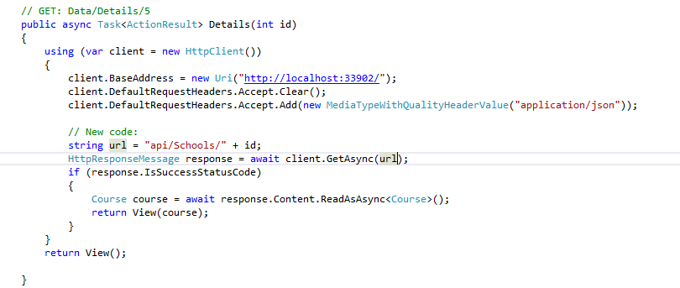
Async / Await
Caller of ‘Details’ action
1
4
Await suspends progress and yields control to the caller of the Details method
2
Returns a commitment (Task) to deliver a HttpResponseMessage
3
HttpClient.GetAsync(string Url)
5
When GetAsync has
Finished → will resume at
this line of code
Notes:
A good link to information about Async/Await is : https://msdn.microsoft.com/en-us/library/hh191443.aspx

Slide 11
Async / Await
Async method includes at least 1 await expression
3 things to note in the signature
The method has an async modifier
The return type is Task or Task<> e.g. Task<int> when the return statement returns an integer
The method name ends with Async

Slide 12
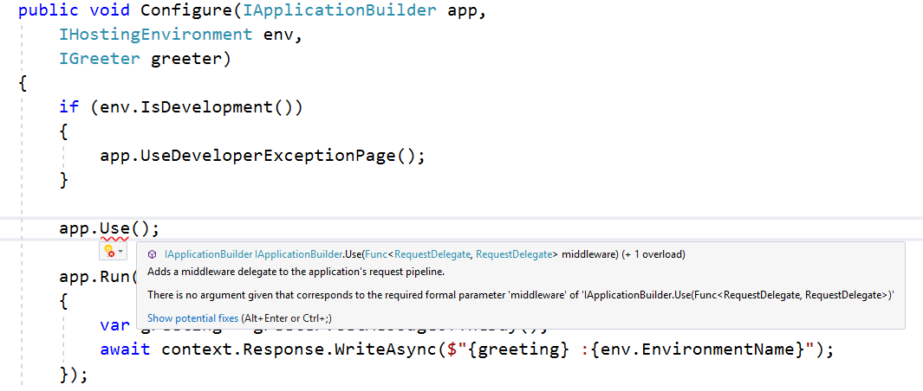
Use IApplicationBuilder
Notes:
Use IApplicationBuilder
For those of you who are wondering about middleware and how it might operate, at a lower level, let us do a little bit of a demonstration.
In order to follow this demonstration, you need to be comfortable with delegates and .NET and the func type.
What we want to show you is how to write a piece of middleware using the app.Use method.
This allows us to write a slightly lower level piece of middleware than app.Run.
App.Use requires us to pass in a function that takes a request delegate and returns a request delegate.
A request delegate, by the way, which is a .NET delegate, is an object that contains a reference to a method, so it's executable code, it's a function, a request delegate is something that takes an HTTP context and returns a task.

Slide 13
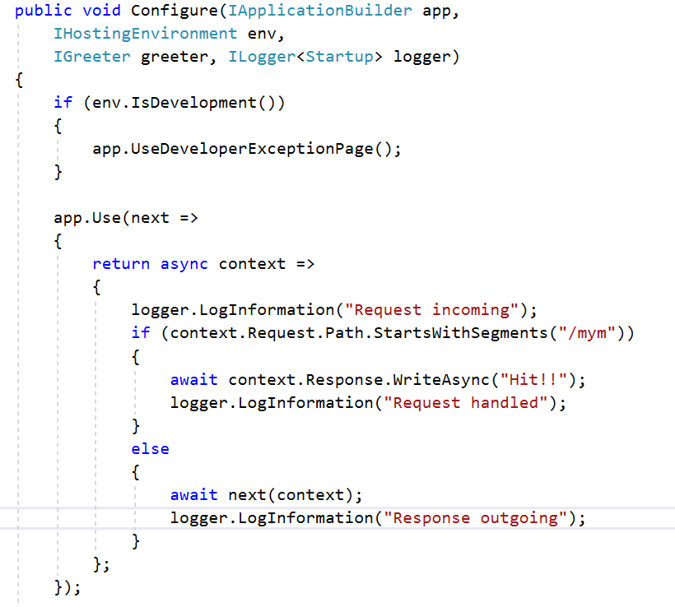
Use IApplicationBuilder
Notes:
Use IApplicationBuilder
It's typically going to be an async method. So with app.Use, we need to pass in a function.
We’re going to give this function a parameter that we name “next”, because this parameter, which is a request delegate, really represents the next piece of middleware in the pipeline.
If we choose to invoke next inside of our middleware, then we are choosing to allow the next piece of middleware to process this request. We'll see that in just a moment.
What we need to return is a request delegate. That is a function that takes an HTTP context object and returns a task.
What we'd like to show you is how to conditionally process a request, that is, we only want to handle a request inside of this piece of middleware if we reach a specific path (just like the welcome page is doing here); otherwise, we want control to flow through to the next piece of middleware, which is UseWelcomePage.
In order to make this more obvious, let's write out some logging information inside of my middleware.
We’re going to ask ASP. NET to give us, in addition to IApplicationBuilder and IGreeter and so forth, ILogger that is specifically configured for this startup class.
ILogger is another service that you can ask for in almost any ASP.NET component, so you can write out logging information. We just need to bring in the namespace, Microsoft.Extensions.Logging.
Now what we can do inside of our middleware is going to write some information, log some information, that this is a request incoming.
Because at this point in our middleware, we have just received a call from ASP.NET Core telling us about a request.
Everything about that request we can get to through this context object.
For example, we could say if context.Request.Path starts with a segment /mym (my middleware) then we want to do something with our middleware.
We don't want control to pass to the next piece of middleware, we want to write out a response.
We can do that using the await keyword, which means we will make this an async lambda. We will await the result of using context.ResponseWriteAsync, so we’re going to go to the response, and we will write async, just that we hit this middleware.
Otherwise, what do we do?
Well if we’re not going to handle the request and we’re not going to produce a response, we should give the next piece of middleware in the pipeline a chance to respond.
We can do that by invoking the request delegate that we were given, so invoking next.
That requires us to pass along an HTTP context, (the context that we've received) and we can also await the processing of that next piece of middleware.
We add some more logging statements. First of all, we add the logging of “Request incoming”, If we reach the if statement, we add the logging of “Request handled”; otherwise, we add the logging of “Response outgoing”.
Because there's many different reason that you might write a custom piece of middleware, but most middleware is there to either look at an incoming request, or look at outgoing responses, or trying to handle requests in some manner.
And everything is really about the request incoming. Once you call next, some other piece of middleware might have already started to write a response.
Going back to that diagram that we had on an earlier slide, after you call next, this is control flow going back out of the pipeline.

Slide 14
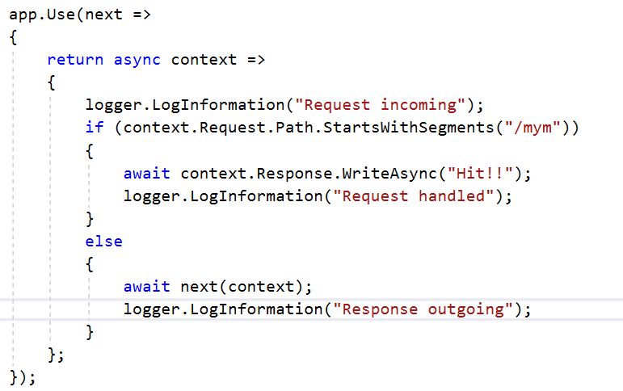
Use IApplicationBuilder
Notes:
Use IApplicationBuilder
We also want to point out, because this might not be obvious, the outer function that we pass into app.Use is only invoked once.
ASP.NET Core invokes this function when the framework is ready to set up the pipeline.
This function needs to return the middleware function to ASP.NET Core. The inner function that we are returning to the caller, this is the middleware.
This is the function that is invoked once per HTTP request that reaches this middleware.

Slide 15

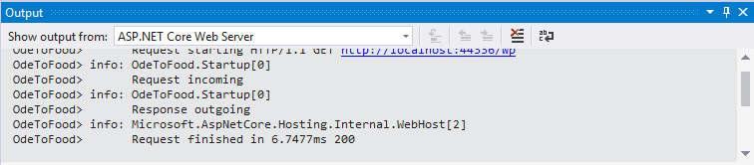
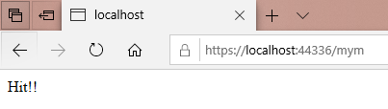
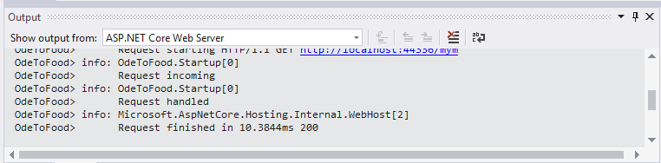
Use IApplicationBuilder
Notes:
Use IApplicationBuilder
Save this and when running, view the Output window, and let's go over to ASP.NET Core Web Server in the drop down list.
This will actually show us the logging information that's being logged, so we’re going to clear everything that's here and come back to the browser, and let's do a refresh on /wp.
This changed our output, and we can see “Request incoming”, “Request outgoing”.
The request for /wp was handled by this piece of middleware, and it just sort of traveled through our middleware.
We looked at the request, wasn't interested, invoked next, and the welcome page handled this.
But if we come to /mym, our middleware is hit.
We should be able to see in the output that request was incoming and the request was handled.
Although this was a very quick introduction, hopefully this gives you some deeper insight into how this middleware processing pipeline actually works.

Slide 16
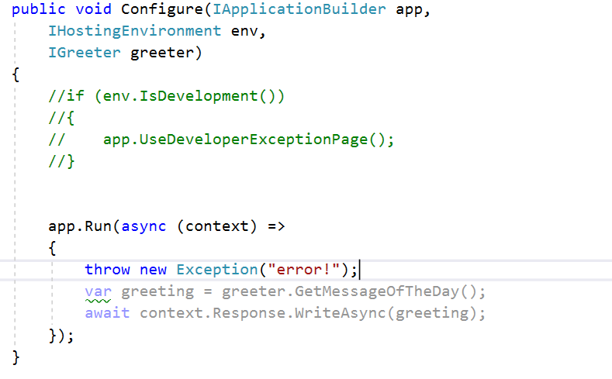
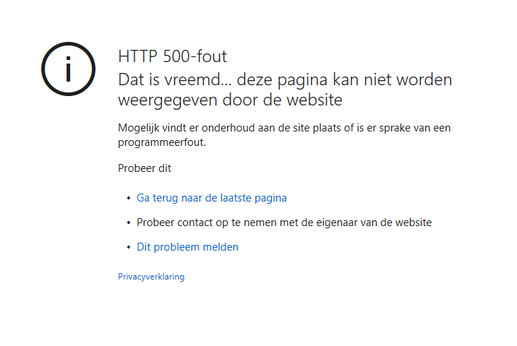
Showing Exception Details
Notes:
Showing Exception Details
What happens when something goes wrong inside of our application?
What we’re going to do inside of app.Run is throw a new exception and pass along the message error. This will happen with every single request that comes to our application.
We will receive a display that's actually generated by the browser, because all the server did was return an HTTP 500 error.
In some browsers, you might not see anything at all; it just happens that in Microsoft Edge there's a somewhat friendly UI that's programmed into the browser to tell you that the server couldn't respond.
This is not typically something that I want to show an end user when they're using your application and something goes wrong. What we generally want to do is show them a page, perhaps with an email address or a phone number to contact support. If you’re a developer, you really want to have more details on what happened back on the server. And that's the purpose of the UseDeveloperExceptionPage. We’re just going to uncomment the line of code that adds this piece of middleware to the pipeline. We'll come back and talk about the if statement here next.

Slide 17
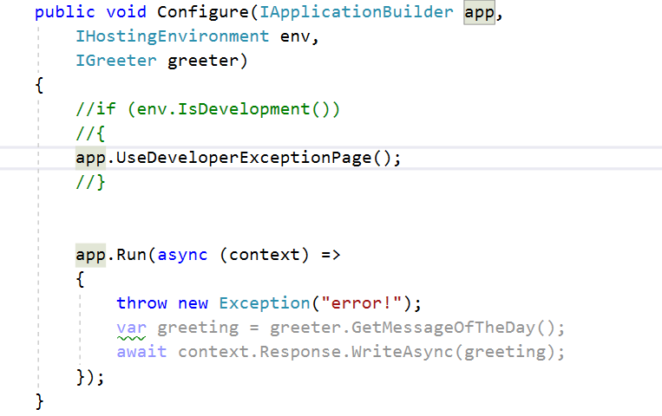
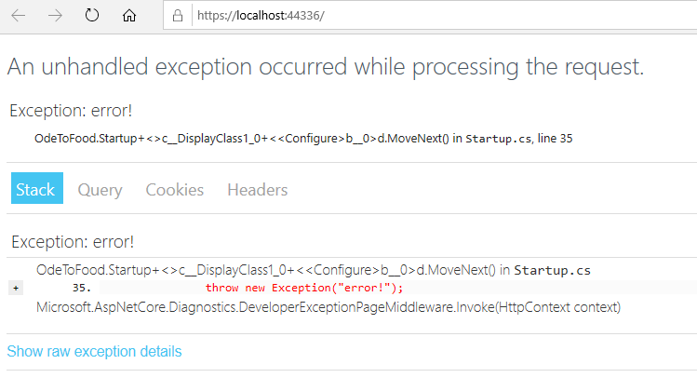
Showing Exception Details
Notes:
Showing Exception Details
Most pieces of middleware that you install are pieces of middleware that inspect an incoming request.
It wants to inspect that request to do some logging or to examine authentication cookies, or to perhaps produce some HTML (like the welcome page did).
The developer exception page middleware is different.
The developer exception page middleware just wants to sit at the front of the pipeline and allow all requests to flow through to other pieces of middleware.
t really doesn't care about the incoming request. But if another piece of middleware later in the pipeline throws an unhandled exception, that's when the developer exception page can jump in.
The developer exception page can catch that exception and prevent that scenario where we don't send a body back in the response to the web browser.
What the developer exception page will do instead, is give us a user interface that a developer might like.
You can see that we made a request to the web server, there was an exception. we can even see that that exception happened on line 37 of Startup.cs, which is very useful information for debugging.
You can see some additional exception details, a full stack trace, you can look at the query string, any cookies that were involved in this request, and any other headers that were sent, which is all very useful information that you can use as a developer to come back and fix the application, which in this case is just getting rid of this hard-coded exception.
Of course, that's not the type of user interface display that you want for the average end user.
They're not going to be interested in a stack trace. In fact, some stack traces can give a user too much information, information that a malicious user might use against you.
You want to prevent that information from reaching anyone when you’re on a production website.
That's a situation where you can match your middleware to the specific environment that you’re operating in.
Let's talk about that next.

Slide 18
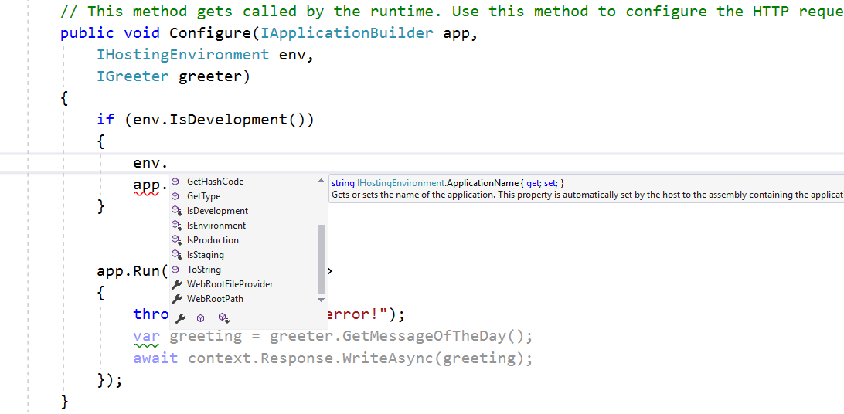
Middleware to match the environment
Notes:
Middleware to match the environment
ASP. NET Core has the concept of a runtime environment.
We can find out information about the environment that your application is running inside of by going to the IHostingEnvironment service.
This is one of those services like IGreeter and ILogger that you can inject into components throughout the application, and here we're asking for that service inside of our configure method.
With this service, you can find out various pieces of information about the environment that you’re in, like your ApplicationName, as well as the absolute path to some significant folders inside of your application.
You can also ask about the type of environment. Is this a development environment or production environment or a staging environment?
Those are three well-known environments for ASP. NET Core.

Slide 19
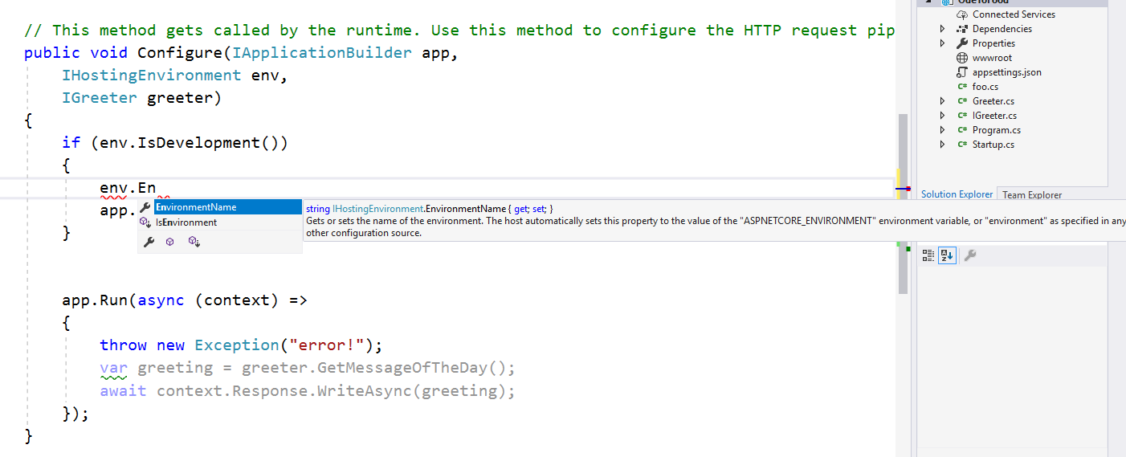
Middleware to match the environment
Notes:
Middleware to match the environment
You can also create your own arbitrary names (like QA if you wanted a QA environment).
The obvious question then is how do you set or control this environment?
IHostingEnvironment.EnvironmentName will give you a string value (a name like development, production, staging or QA). You can also set the name here, but commonly what you do with ASP.NET Core is, you set the environment using an environment variable, and then name of that environment variable is ASPNETCORE_ENVIRONMENT.
The default environment name is production, since that is the safest choice.
But if you set an environment variable with the name ASPNETCORE_ENVIRONMENT to the value development, and then run the application with that environment variable in place, that is when this method IsDevelopment would return true.

Slide 20
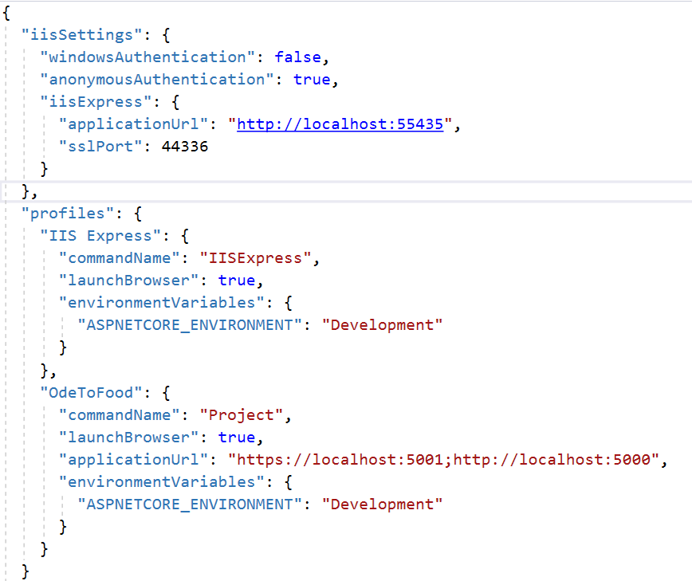
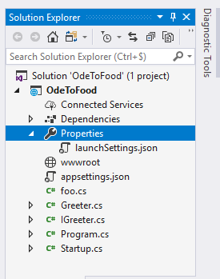
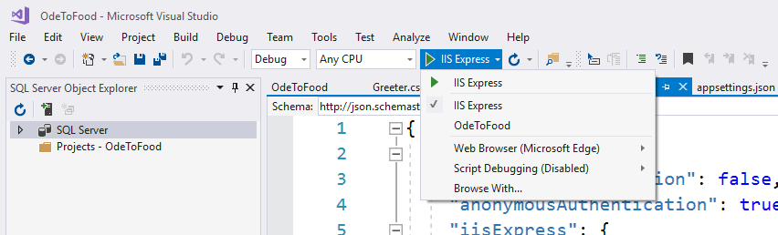
Middleware to match the environment
Notes:
Middleware to match the environment
We’ve seen the DeveloperExceptionPage at work.
We’ve seen it when we run without debugging from Visual Studio.
So, where does this environment variable get set when you run from Visual Studio?
The answer is that inside of the properties for this solution, there is a file launchSettings.json.
Other tools like the .NET CLI tool that we looked at earlier also respect the settings that are in launchSettings.json.
You can use these settings even if you're not using Visual Studio, you can use this with other tools.
Inside of this file, you can set up multiple profiles, that is, multiple different ways to execute your application.
This first profile says you want to run your application through dotnet run, but under IISExpress.
When you select to run under that profile, you want your tools to automatically set up an ASPNETCORE_ENVIRONMENT variable with the value ‘Development’.
Currently every time we run with Visual Studio, whether it's with the debugger or without the debugger, we are using this IISExpress profile.
We know that because in the toolbar, in this little dropdown, you can select the profile that you want to use when executing.
Currently it's set to IIS Express. you can also select the profile OdeToFood. We can see those profile settings inside of launchSettings.json also.

Slide 21
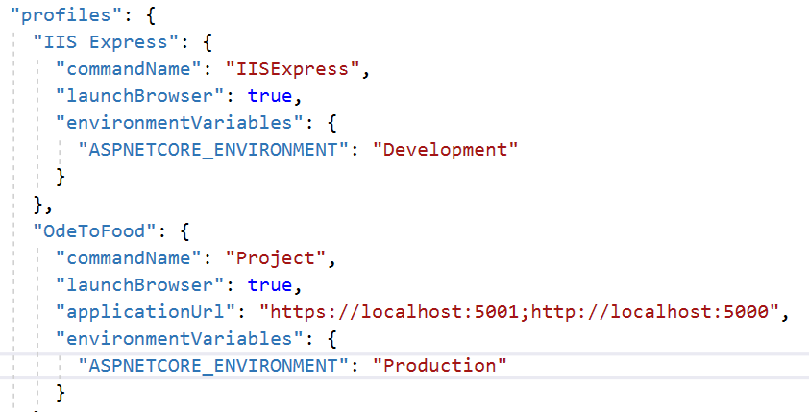
Middleware to match the environment
Notes:
Middleware to match the environment
In that case, when the settings file says “commandName”:”Project”, this is really saying behind the scenes use “dotnet run” to start your project, but you still want you to set an ASPNETCORE_ENVIRONMENT variable to the value Development.
Let's change that, and let's set this to Production. We want to show you how to run with this profile, at least when you are inside of Visual Studio.

Slide 22
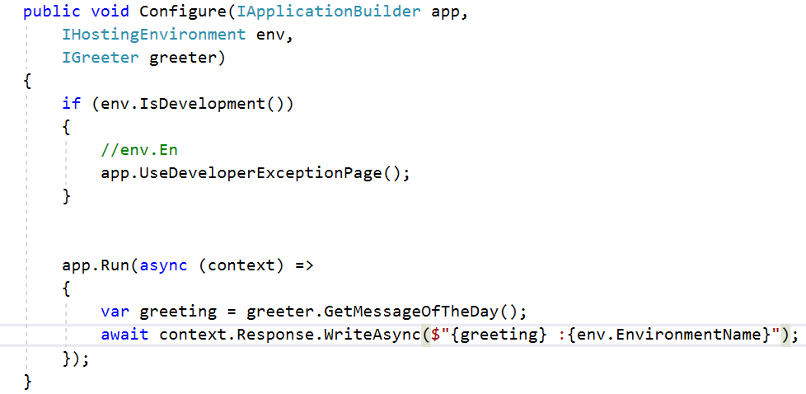
Middleware to match the environment
Notes:
Middleware to match the environment
We also want to change our startup file.
In the startup, in addition to writing out the value of the greeting, let's also write out IHostingEnvironment.EnvironmentName, so that we know we have the write setting.

Slide 23
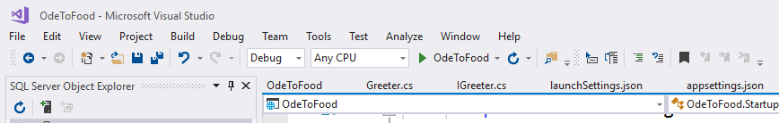
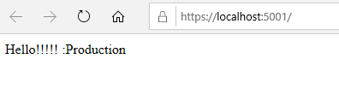
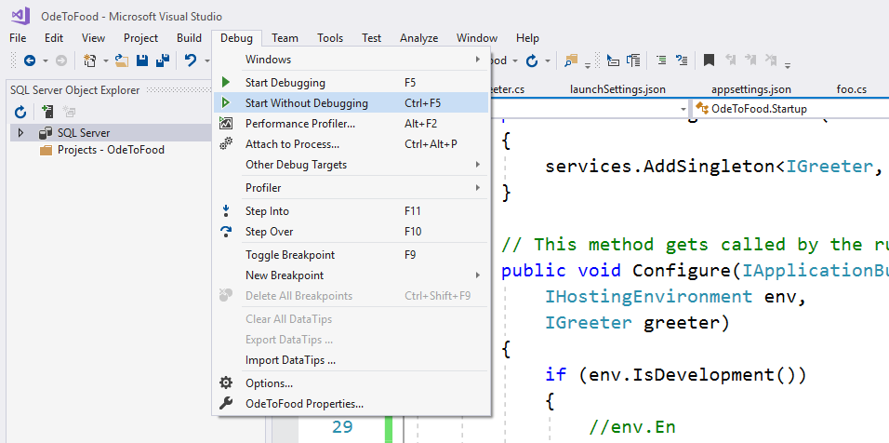
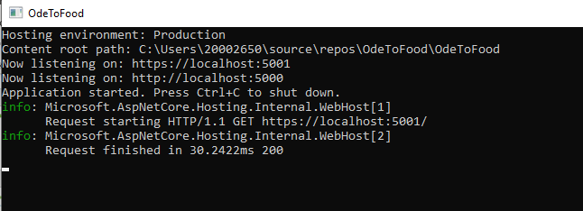
Middleware to match the environment
Notes:
Middleware to match the envrionment
Let’s save all the files and select the OdeToFood profile, then start without debugging.
What we should see is that a command-line window pops up and that a browser opens.
You do see “Hello!!!! :Production”.
We are running in the Production environment.
At the command-line, you can see this is the same output that we would see if we used dotnet run.

Slide 24
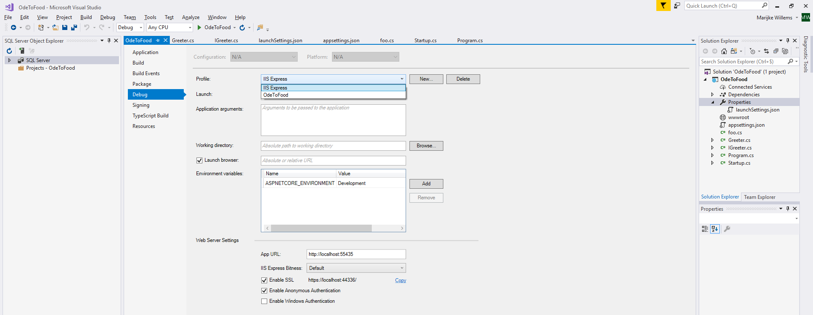
Middleware to match the environment
Notes:
Middleware to match the environment
One way to add and remove profiles is to come into Visual Studio or Visual Studio Code and modify launchSettings.json. If you want a friendlier way to do this, you can also right-click on a project when you're inside of Visual Studio, come into the properties, and come to this Debug tab.
You can see the list of profiles from launchSettings are displayed in a dropdown list inside of Visual Studio. You can create a new one, you can delete a profile.

Slide 25
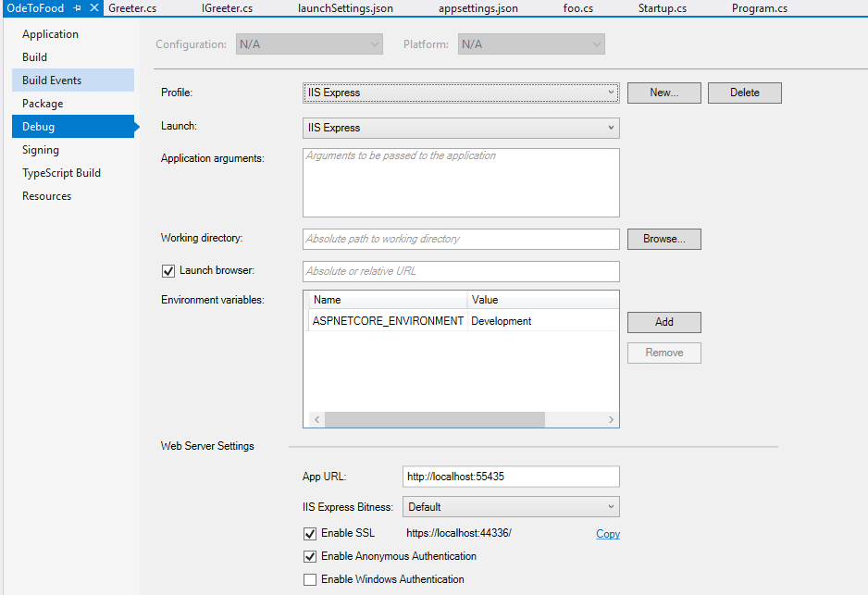
Middleware to match the environment
Notes:
Middleware to match the environment
It's inside of here where you can modify profiles.
We want this profile to launch using IIS Express. We want the environment variable ASPNETCORE_ENVIRONMENT to have the value “Development”. We do want to launch the browser when we run.
This is where we can set the starting port, and where we could enable SSL, which we'll do later in the course.

Slide 26
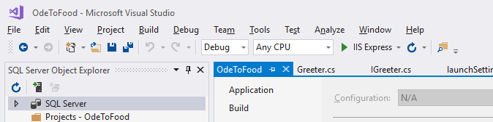
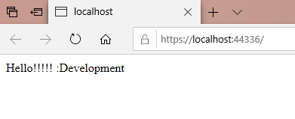
Middleware to match the environment
Notes:
Middleware to match the environment
For right now, We’re going to switch back to using the IIS Express profile, and just to double-check things let's start without debugging again.
This time we want to see the Command Prompt open, and this time we do see Hello!! : Development.
The way that you can use these different environments is to customize your application to the environment.
When you’re in development, you want to see an exception page that shows you details about the exception. you want to see stack traces.
Your user typically doesn't want to see that, so if you’re in production or any other environment but development, you might use a different piece of middleware that will allow you to show a different UI to the user (something like, “sorry, something has gone wrong, here's the phone number or the email address to contact support”). We'll use that a little bit later in the course.

Slide 27
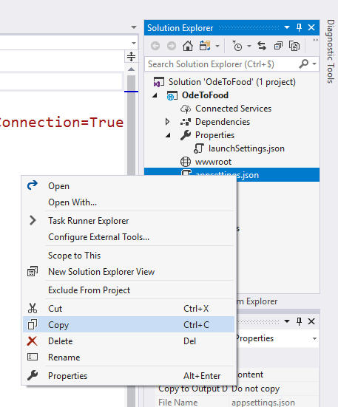
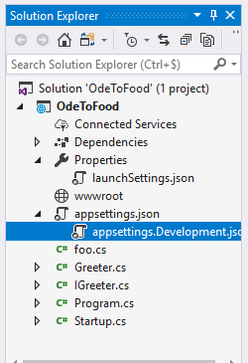
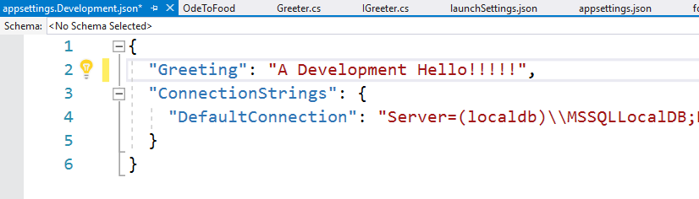
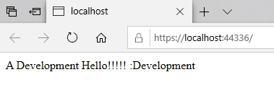
Middleware to match the environment
Notes:
Middleware to match the environment
You can have multiple appsettings files based on the environment name.
By default, the application will use appsettings.json.
We can copy this and paste it into Solution Explorer again and rename it.
What ASP.NET Core will also look for in addition to appsettings.json is an appsettings.environmentname.json file.
So if you rename your copy to appsettings.Development.json, any settings in this file will override the settings that are in appsettings.json.
This would allow you to do things like define different database connection strings for different environments.
Let's go into appsettings.Development.json and change the greeting to “A development Hello!!”, save this file, start without debugging.
We now have a settings file that will contain settings specific to a development environment.

Slide 28
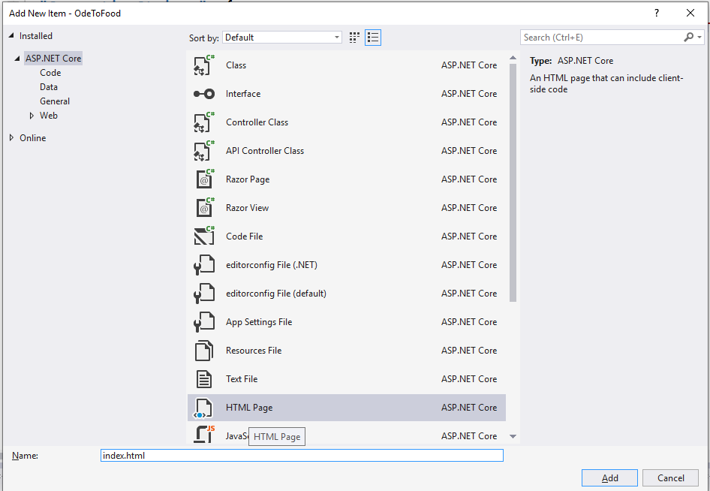
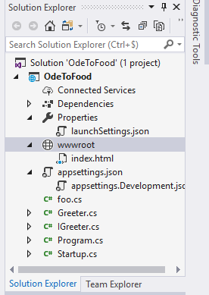
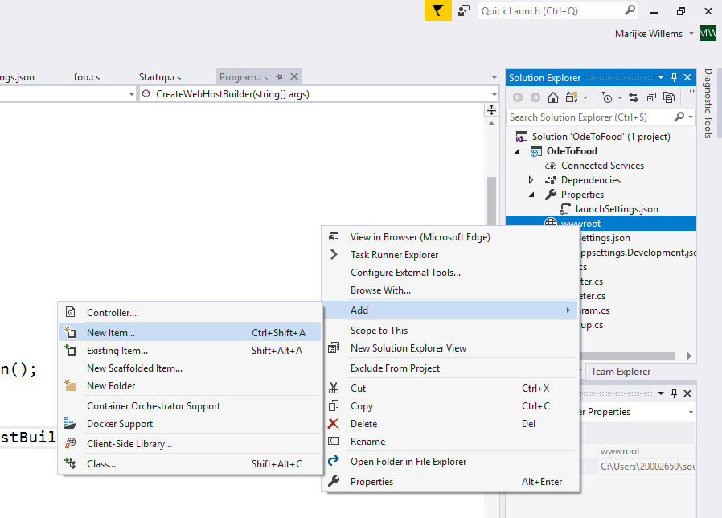
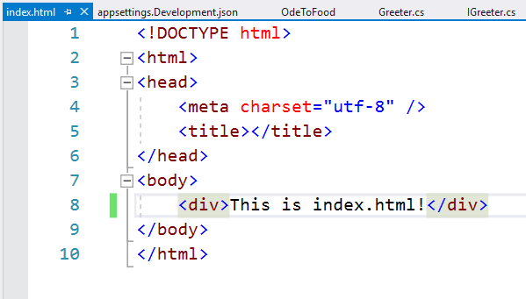
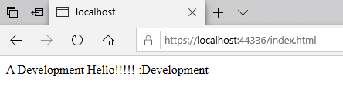
Serving Files
Notes:
Serving Files
We hope by now that you're starting to see how middleware entirely defines how my application is going to behave and respond to HTTP requests.
Right now the only thing your application can do is show a friendly developer exception page when there's an unhandled exception, and display a message of the day.
We do not even have the ability to display static files from the filesystem. Most applications need that capability.
We need to serve up JavaScript files, CSS files, image files, HTML files, and in previous versions of ASP.NET, you could just add those files anywhere inside of your application and ASP.NET would serve those files.
With ASP. NET Core, you cannot serve any files from the filesystem until you install a specific piece of middleware that will add that feature to your application.
By default, that middleware is only going to serve files that are in the wwwroot folder or some subfolder of that folder.
One reason for that is that it's easy to place all of your static content in that folder and not have to worry about blocking requests to special files like source code files, .cs files, or appsettings.json, which might contain some sensitive information like a connection string.
Add a folder with the specific name “wwwroot” to the project.
First, let's create an HTML file inside of the wwwroot folder, right-click on wwwroot folder → add a new item →HTML Page (index.html).
Inside of this file, we add some simple markups, so perhaps a div, and save it!
Once we save this file and come back out to the application, which is still running, and refresh, even if we tried to go to index.html, the only response we can receive from our application is this greeting that we have configured to respond to every request.

Slide 29
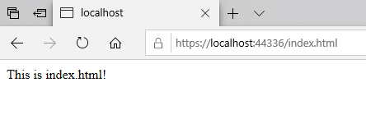
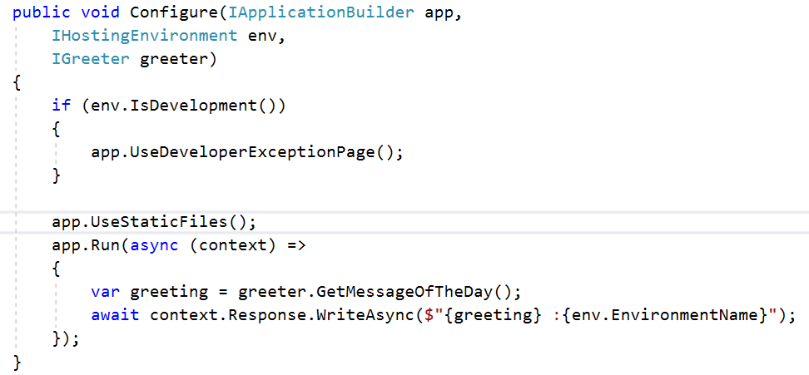
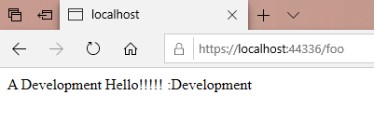
Serving Files
Notes:
Serving Files
However, there is a piece of middleware that we can install inside of Startup.cs. We do that using app.Use.
The name of the method that we want is UseStaticFiles.
With that piece of middleware in place, and in the browser we navigate to /index.html, that piece of middleware has inspected that request, it's gone out to the filesystem, it has found an index.html file, so it's going to pick up the contents and stream them back to the user.
A request for any other URL, for example /foo or /bar, those requests are going to fall through the static files middleware, because it doesn't find a matching file with that name, and go back to the app.

Slide 30
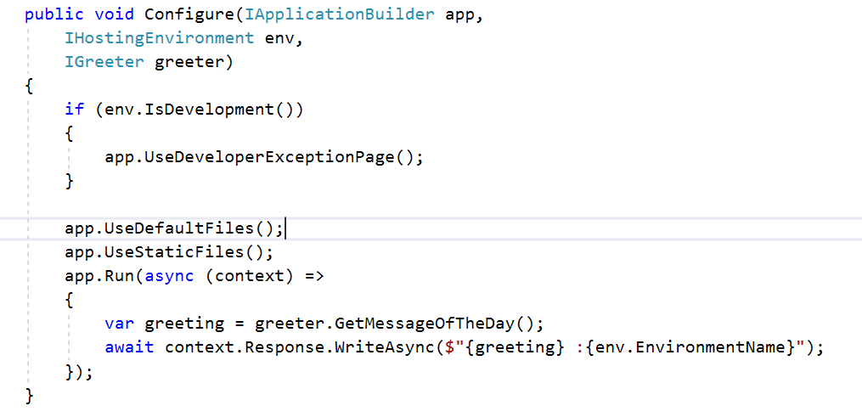
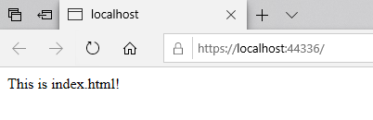
Serving Files
Notes:
Serving Files
Run middleware, which is just going to display the greeting.
What if we wanted index.html to be our default file?
That is, if someone requests the root of the website, you want to respond with index.html.
If that's the case, there's another piece of middleware, which is UseDefaultFiles.
What default files will do is look at an incoming request, and if that request is for a directory, like the root of an application, this piece of middleware will look inside of that directory to see if there is a default file.
The default filenames are configurable, but one of the default default filenames is index.html.
Like every other piece of middleware, there's an options object that you can pass in to UseDefaultFiles, and you can specify what default files you want to look for.
Since index.html is a default, all we should need to do is save Startup.cs, come back to our browser and refresh, and request to the root of the website will find index.html.
This is another example of where the order in which you place middleware is important, because UseDefaultFiles will do is not serve up the default file, that is, it's not going to read that file from the filesystem and send it back to the user, instead UseDefaultFiles will simply change the request path, and then invoke the next piece of middleware, which is UseStaticFiles, and if UseDefaultFiles changes the request to make it look as if the request was actually going for index.html, then UseStaticFiles can serve up that content.

Slide 31
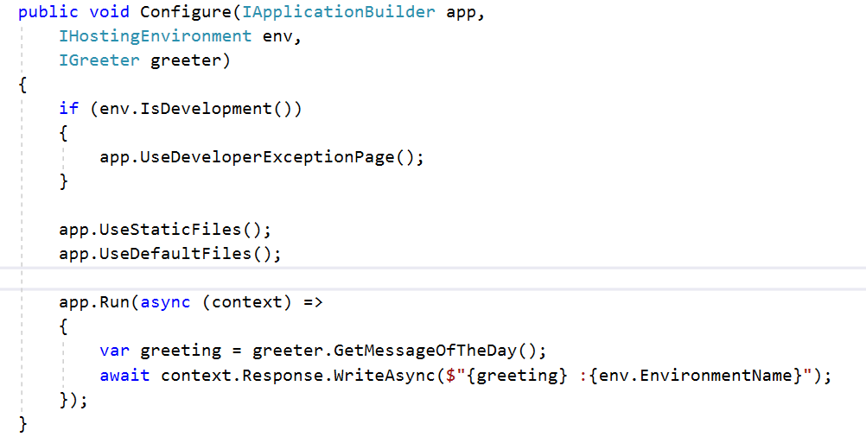
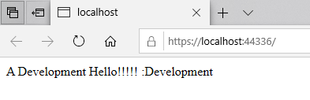
Serving Files
Notes:
Serving Files
If we were to swap these two lines of code, the application wouldn't behave as expected.
We need to use default files before we use static files, so that default files can properly define the environment for static files to work.

Slide 32


Serving Files
Notes:
Serving Files
If we want both of these behaviors, there's another extension method that behind the scenes will actually install a couple different pieces of middleware, but this is UseFileServer.
What UseFileServer will do behind the scenes is install the default files middleware, as well as the static files middleware, and there's an options parameter we can pass in to enable things like directory browsing, but UseFileServer should also allow us to serve up index.html from the root.
If we go to another path like /foo, we’re back to our greeting.
Because static file sees that that does not match a file that's on the disk, and then it allows the request to flow through to the next piece of middleware, which is my app.Run middleware.
With this point, we are handling exceptions, we are serving up static files, and what we want to look at in the next chapter is the MVC Framework.
We want to start looking at controllers specifically in the MVC Framework.
In order for the MVC Framework to work, we're going to need to install some middleware and also some services that the MVC Framework will require.

Slide 33

Setting up ASP.NET MVC Middleware
Notes:
Setting up ASP.NET MVC Middleware
Ultimately we want to build a web application on top of ASP.NET Core, and specifically we want to use the ASP.NET MVC Framework, although we could build an entire application just using middleware.
ASP.NET MVC, the model view controller framework, that framework gives us some additional features that makes it easy to create HTML pages and HTTP-based APIs.
The MVC Framework makes this easy, because we can map an incoming request to a method on a class, and inside of that method it becomes easy to query a database or read a file.
We can execute all sorts of logic and do calculations and then respond to the user by building HTML, XML, or JSON. We'll see how all that works in the rest of the course.
For now, we just want to see how to get set up to use the MVC Framework.
Step one is to always make sure that we have the Microsoft.AspNetCore.MVC package installed. That gives us access to the assemblies and classes provided by the MVC Framework.
Once the package is installed, we need to register all these services that ASP.NET MVC requires at runtime. We'll do this inside of the ConfigureServices method, where we also configured our IGreeter service since the application. Finally, we need to add middleware for ASP.NET MVC to receive requests. Essentially the middleware takes an HTTP request that comes in and tries to direct that request to a C# class that will handle that request. We'll show you a bit about what that class can look like in this chapter, but we'll go into much more detail in the next chapter.

Slide 34

Setting up ASP.NET MVC Middleware
Dependencies → Nuget → Microsoft.
AspNetCore.App → expand
Notes:
Setting up ASP.NET MVC Middleware
For right now, we just want to have all the setup in place that we can move forward.
As mentioned, the first step in working with the MVC Framework is to make sure that we have a specific NuGet package installed.
When we create a project using the empty template with Visual Studio and dotnet run, we just want to show you that we have one package reference for the entire application. That's the Microsoft.AspNetCore.App package.
This is what we call a meta package.
It's a package that brings in other NuGet packages, and as the name implies, this brings in all the ASP.NET Core packages.
That includes the MVC Framework.
We can verify this if I go to Dependencies. What Dependencies can show you is all of your primary dependencies, for example, we depend on Microsoft.AspNetCore.App, as well as dependencies of your dependencies.
If I expand this node, you can see all of these subpackages that are brought in, and that includes. Microsoft.AspNetCore.Mvc.
In fact, there's a number of MVC-related packages that the App package brings in.
We don't need to explicitly add a NuGet reference if we’re using Microsoft.AspNetCore.App. But we do need to add the services and we do need to add the middleware.

Slide 35


Setting up ASP.NET MVC Middleware
Notes:
Setting up ASP.NET MVC Middleware
First, let's change this back to using just a static files middleware.
That's because we only want to respond with a static file if an incoming request exactly matches that static file.
Otherwise, we want the request to pass through to the next piece of middleware, which will be using the MVC Framework with default route.
We will explain more about routing in the next chapter.
The MVC Framework has some specific inventions that when it sees an incoming URL, it looks at specific pieces of that URL to map that request to a method on a class that the MVC Framework will instantiate.
We'll give you a preview of what that class looks like.
Save this file, do a refresh, just to show you that you missed a step.
We see an exception telling us that the MVC Framework was unable to find the required services.
So, in additional to any custom services that we might want to register for our application, like the IGreeting service, we might also need to add more framework services that just aren't there by default, and the MVC Framework is a good example.

Slide 36

Setting up ASP.NET MVC Middleware
Notes:
Setting up ASP.NET MVC Middleware
The MVC Framework requires a number of services that it will use to do things like turn a view into HTML.
We'll see how that works later in the course. But since those services are not there by default, we need to explicitly add them inside of ConfigureServices.
Of course, there's going to be overloads of this method that we can use to configure some specific behavior of those services.
We'll see that later in the course, but now that we have a NuGet package installed, we have the services registered, we have middleware in place that will route my request through the MVC Framework, it's now time to create a controller, because ultimately with the MVC Framework, you want to direct an incoming request to a controller.

Slide 37

Setting up ASP.NET MVC Middleware
Right-click → Add new Item → Class
Notes:
Setting up ASP.NET MVC Middleware
Actually throughout this course, we'll see a number of different ways to handle requests with the MVC Framework, but the C in MVC stands for controller, and what we want to do is go ahead and create a new folder in our application.
Let's call this Controllers. This will be where we place the controllers for the application.
Inside of that folder, we’re going to add a new item.
And although you will see MVC Controller Class in the template, we’re going to go with something a little more general, we’re just going to add a C# class.
We will call this class HomeController. That name is significant, because again, the MVC Framework has some very specific conventions about how it will map an incoming request to a method on a class.

Slide 38


Setting up ASP.NET MVC Middleware
Notes:
Setting up ASP.NET MVC Middleware
By default, it is the HomeController that will receive a request to the root of the application.
If we request the root of the application, the MVC Framework should see that request, it will instantiate this class.
Then it will invoke a method or it will first look to see if this method exists, but if it finds an Index method, the MVC Framework will invoke this method, and whatever we return will influence what the user sees in the browser.
For right now, we’re just going to return a simple string, which is “Hello from the HomeController”.
This class doesn't need to derive from any specific base class, we will do that later in the course, because there is a base class that we can use that gives us a lot more features.
But right now we just want to save all the files in the application.
Come back to my web browser, and let's issue a request and make sure this goes to the root of the website.
We'll see “Hello from the HomeController”.
At this point, we are ready to start working with the MVC Framework, and we'll do that in the next chapter by looking at routing and how to write these controller classes.

